Slide 1
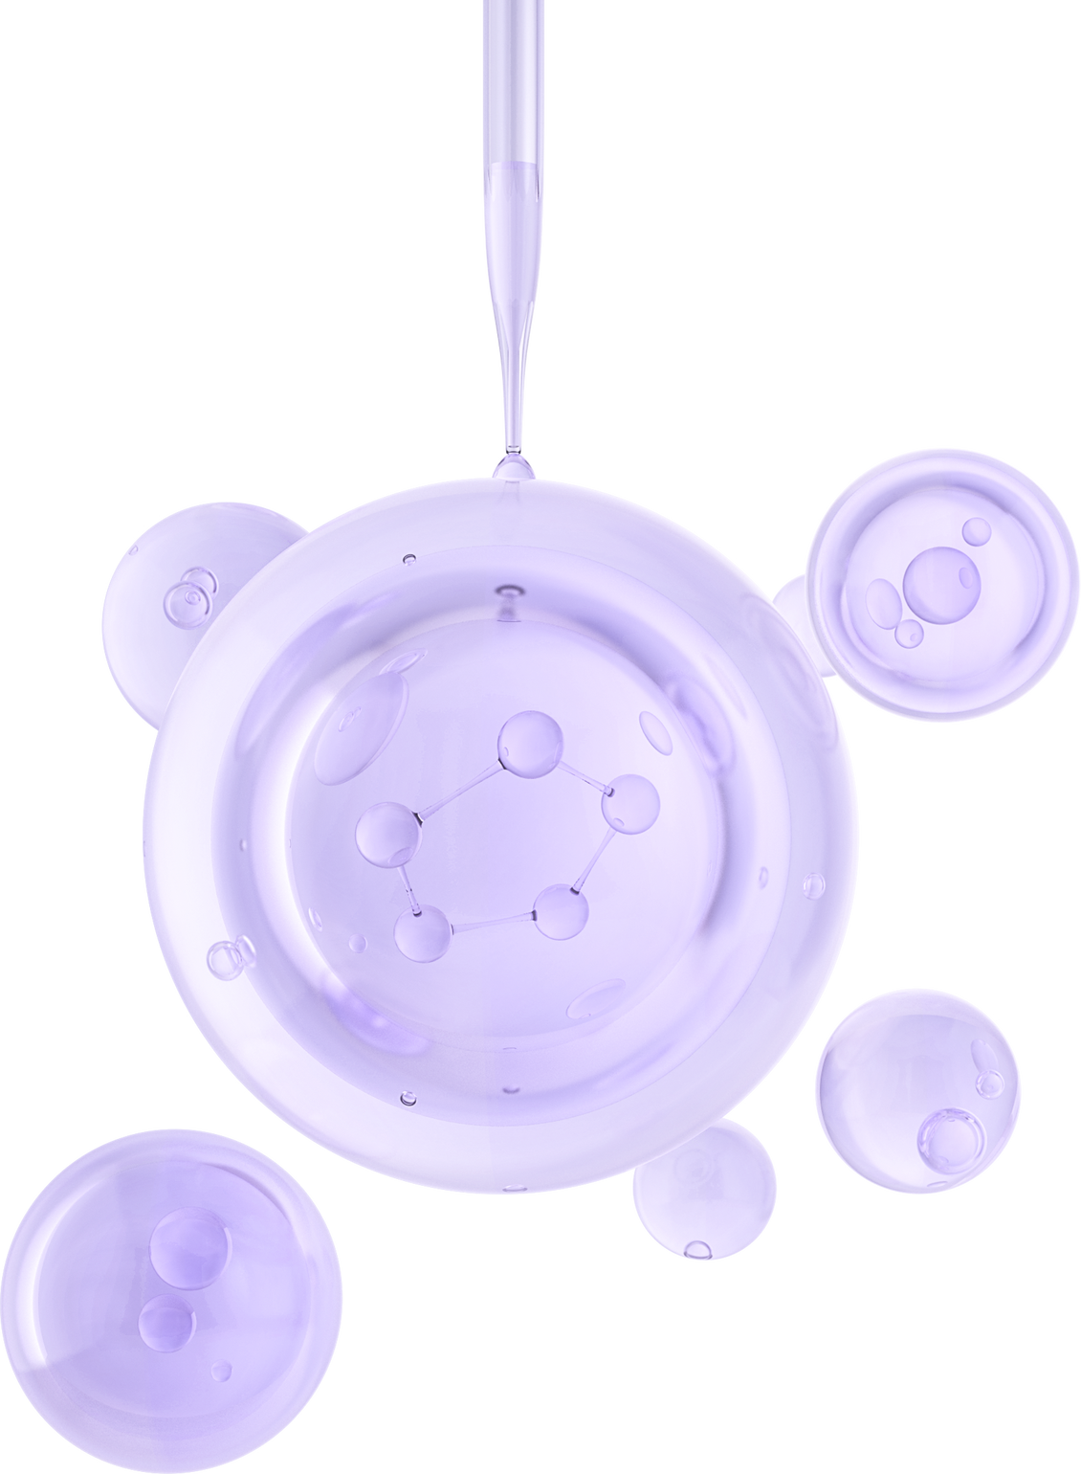
NOVAMOL
GENERATIVE MODEL FOR NOVEL CHEMICAL MOLECULES
Group No: 17
Group Members:
Ahmed Abdul Wasae - A0328301R
Hari krishna Dhamodaran - A0333806E
Raja Vijayakumar - A0327096X
John Joseph Peter - A0328845R

Slide 2
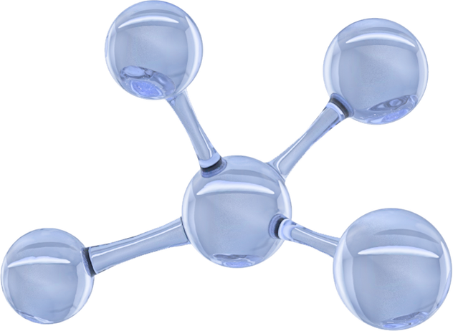
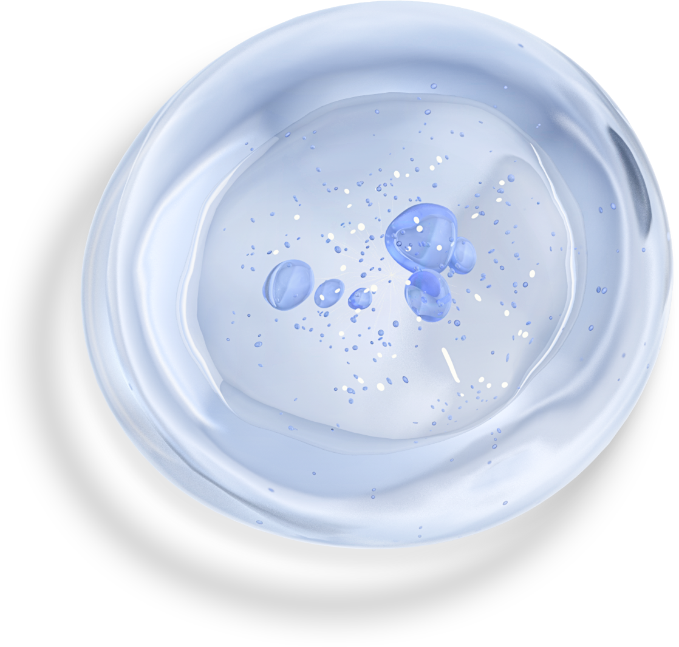
Introduction
Discovering new molecules and understanding their properties is a critical step in developing advanced drugs, sustainable materials, and innovative chemicals. Traditional discovery methods are often slow, costly, and resource-intensive. This project leverages artificial intelligence to identify patterns in existing molecular structures and properties, enabling the generation of novel candidate molecules and the prediction of their potential functionalities. By combining data-driven techniques with chemical knowledge, the project aims to accelerate molecular discovery while reducing experimental costs.

Slide 3
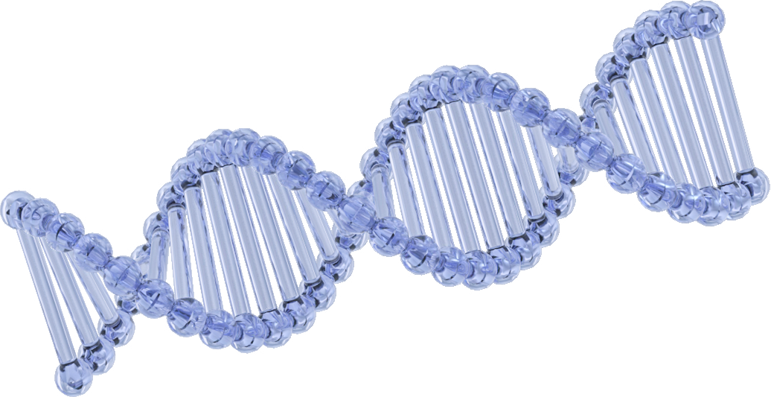
Project Background and Market Context
Problem Today: Discovering new molecules is slow, costly, and trial-and-error based. Traditional lab experiments and simulations take months or years.
Why AI Helps: AI can predict molecular properties without running every experiment. This saves time, money, and resources in discovery.
Market Needs
Pharma: Faster drug discovery and lead optimization.
Materials Science: New polymers, batteries, solar materials.
Food & Fragrance: Novel safe flavour and aroma compounds.
Agrochemicals: Eco-friendly pesticides and additives.
Opportunity: AI-driven molecule generation can shorten R&D cycles. Growing demand for faster, cheaper, and sustainable innovation across industries.

Slide 4
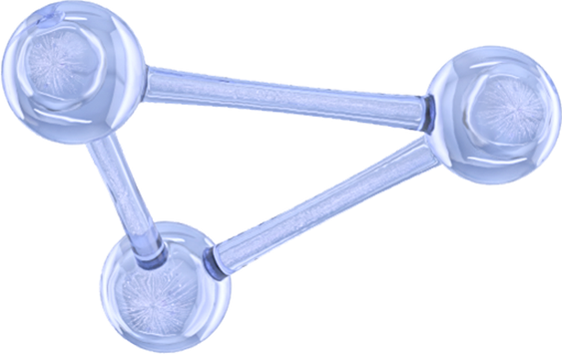
Literature Review
1. Molecular Graph Neural Networks
Paper: “Neural Message Passing for Quantum Chemistry” – Gilmer et al., ICML 2017
Introduced message-passing GNNs for predicting molecular properties.
Paper: “Graph Attention Networks” – Veličković et al., ICLR 2018
Attention-based GNN for molecular and general graph data.
2. Molecular Generation with RNN / SELFIES
Paper: “SELFIES: A Robust Representation of Semantically Constrained Graphs” – Krenn et al., 2020
SELFIES ensure chemically valid sequences for generative models.
Paper: “Molecular Generation with Recurrent Neural Networks” – Segler et al., 2018
Demonstrates SMILES-based RNNs for de novo molecule generation.
3. Graph-based Property Prediction
Paper: “Benchmarking Graph Neural Networks for Molecule Property Prediction” – Wu et al., 2018
Extensive comparison of GNN architectures for quantum chemistry datasets.
4. Integration of Generation + Property Prediction
Paper: “Junction Tree Variational Autoencoder for Molecular Graph Generation” – Jin et al., ICML 2018
Generates molecules as graphs while ensuring chemical validity.
Paper: “GraphAF: A Flow-based Autoregressive Model for Molecular Graph Generation” – Shi et al., NeurIPS 2020
Uses graph-based autoregressive models to generate molecules with target properties.

Slide 5
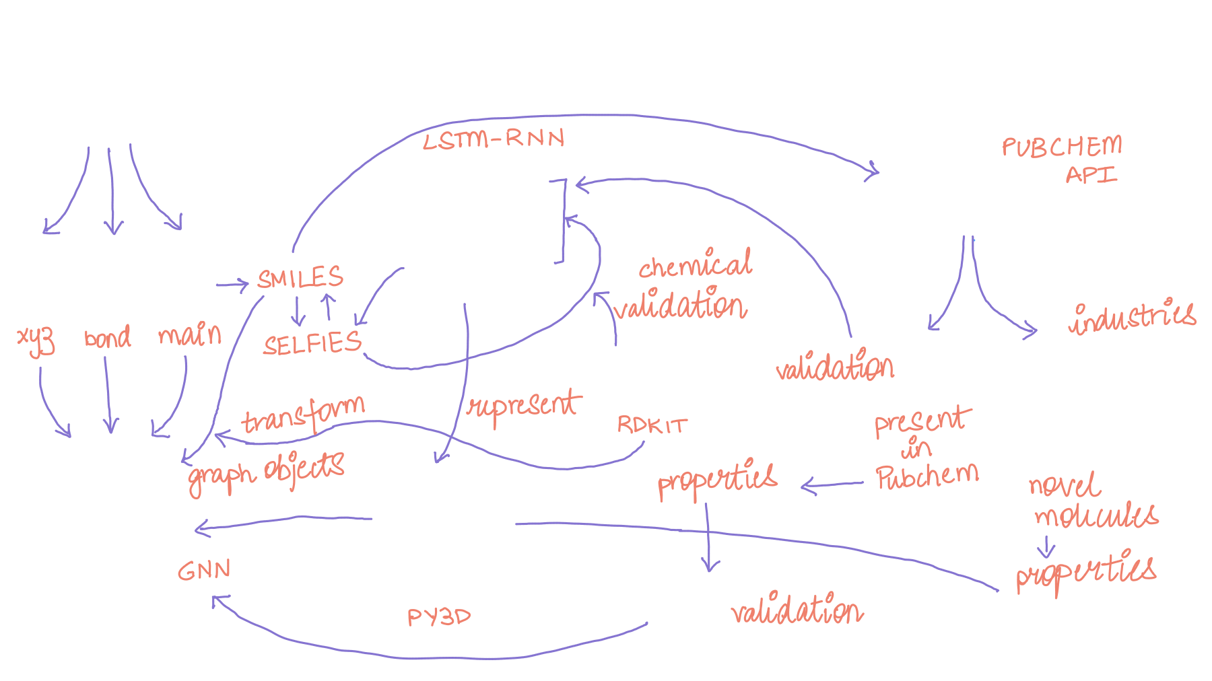

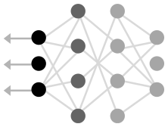
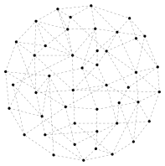
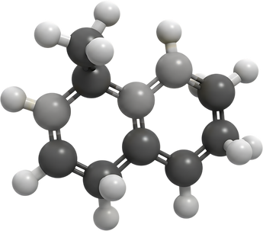
Architecture

Slide 6

Project Scope
The project aims to use AI to automate the task of finding new molecules and predicting their properties by training on existing molecular datasets. This allows researchers and industry professionals to explore new compounds efficiently, assess their properties, and evaluate their novelty.

Slide 7
Methods & Tools for Validation
SELFIES Encoding
Ensures that every sequence generated by the model corresponds to a syntactically and chemically valid molecule.
RDKit Verification
Converts SMILES/SELFIES strings into molecular objects and checks chemical feasibility.(Atom valency, correctness, ring closures and bond consistency, basic stereochemistry validity)
PubChem
Determines if the generated molecules exist in known chemical databases.
Query PubChem using SMILES strings
2. Molecules that return a PubChem CID are known, valid molecules
3. Novel molecules not in PubChem are still chemically valid due to SELFIES/RDKit checks
Fingerprint Similarity
Compares generated molecules to known datasets (QM40, ZINC) to ensure they follow realistic chemical patterns.
Generate Morgan fingerprints with RDKit
2. Compute Tanimoto similarity
3. Low similarity indicates novelty; high similarity ensures plausible chemical structures
Graph-Based Property Prediction
Predict molecular properties (dipole moment, etc.) using GNNs to verify that the molecule behaves chemically realistically using PyTorch Geometric along with the GNN

Slide 8
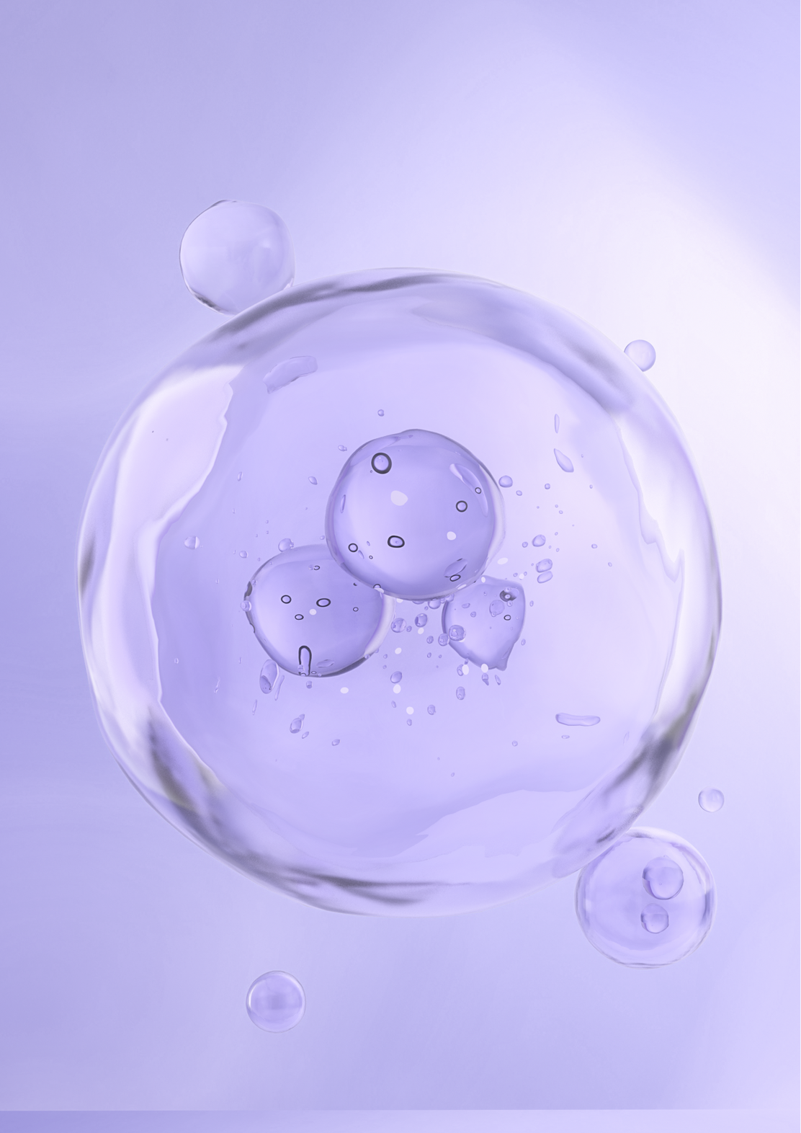
Data Collection
QM40 Molecular Dataset (Kaggle)
Contains ~163,000 neutral molecules from the ZINC database (C, N, O, S, F, Cl)
Provides quantum mechanical data: geometries, energies, Mulliken charges, vibrational properties
Suitable for training and evaluating ML models on structure–property relationships
Manageable size compared to larger QM datasets
Why QM40?
Initial plan: OMAT24 dataset → too computationally intensive
QM40 = efficient alternative for experimentation
Covers diverse molecular properties without overwhelming resources

Slide 9
Initial Challenges and Solutions
Dataset Scalability:
Challenge: The OMAT24 dataset (~20 GB) was too large to handle for preprocessing and training.
Solution: Replaced it with the QM40 dataset, which is smaller (~163,000 molecules) but still comprehensive, containing diverse molecular structures and quantum properties suitable for model training.
Computational Resources:
Challenge: Deep generative models and GNNs require high GPU capacity, which was limited, slowing down training and experimentation.
Solution: Leveraged Google Colab’s free GPU resources for computation, allowing efficient training and experimentation without requiring local high-end GPUs.
Chemical Validity of Generated Molecules:
Challenge: Ensuring generated molecules are chemically feasible and interpretable, despite using SELFIES or SMILES representations.
Solution:
Used RDKit for molecular validation and fingerprint generation.
Checked generated molecules against PubChem to see if they already exist, confirming chemical plausibility.
Verified novelty by computing Tanimoto similarity against the QM40 dataset, ensuring truly novel molecules were chemically valid yet not previously documented.

Slide 10
Domain Knowledge Requirements
To succeed in this project, expertise is needed across multiple disciplines:
Artificial Intelligence / Machine Learning:
Graph Neural Networks (GNNs)
Variational Autoencoders (VAEs)
Recurrent Neural Networks (RNNs) and Transformers for sequence-based molecular generation
Generative models (flow-based, autoregressive, diffusion models)
Chemistry / Molecular Science:
Chemical representations (SMILES, SELFIES, molecular graphs)
Quantum chemical properties (energies, charges, vibrational spectra)
Understanding molecular stability and reactivity principles
Data Science / Engineering:
Handling large-scale datasets (cleaning, preprocessing molecular datasets)
Efficient data storage and GPU-optimized training pipelines
Integrating external APIs (PubChem, RDKit) for molecule validation

Slide 11
Similar AI-Driven Molecular Design Projects
1. Meta’s Open Molecules 2025 (OMol25)
Focus: High-accuracy computational chemistry dataset.
Key Features: Utilizes 6 billion compute hours and 100 million quantum mechanical simulations to model atomic interactions with unprecedented detail.
Significance: Aims to revolutionize drug development and material science by providing a comprehensive resource for AI models. semafor.com
2. Meta’s UMA (Universal Models for Atoms)
Focus: Unified AI model for atoms.
Key Features: Trained on half a billion unique 3D atomic structures, UMA aims to test the limits of accuracy, speed, and generalization across chemistry and materials science.
Significance: Addresses challenges in atomic-level modeling, providing a versatile tool for various chemical applications. ai.meta.com
3. REINVENT 4
Focus: Open-source generative AI framework for small molecule design.
Key Features: Utilizes recurrent neural networks and transformer architectures for de novo design, R-group replacement, and molecule optimization.
Significance: Facilitates the design of novel molecules with desired properties, enhancing drug discovery processes. BioMed Central
4. Variational AI’s Enki™
Focus: Generative AI for drug-like compound design.
Key Features: Rapid generation of selective, drug-like compounds tailored to specific target profiles.
Significance: Accelerates discovery cycles by providing R&D teams with novel compounds beyond existing libraries. Variational AI
5. MIT’s FlowER
Focus: Generative AI for chemical reaction prediction.
Key Features: Predicts chemical reaction outcomes while maintaining real-world physical constraints.
Significance: Enhances the understanding and prediction of chemical reactions, aiding in various chemical applications. news.mit.edu
6. Google DeepMind’s AlphaFold 3
Focus: AI model for predicting biological molecule structures.
Key Features: Predicts structures and interactions of proteins, DNA, RNA, and potential drug molecules.
Significance: Revolutionizes biological research by providing insights into molecular structures and interactions

Slide 12
Appendix
References
AI Tools Assistance
Gilmer et al. (2017) – Neural Message Passing for Quantum Chemistry
Veličković et al. (2018) – Graph Attention Networks
Krenn et al. (2020) – SELFIES robust molecular representations
Jin et al. (2018) – Junction Tree VAE for molecular graph generation
Shi et al. (2020) – GraphAF autoregressive flow models
ChatGPT (GPT-5) – Assisted in drafting diagrams, flowcharts, code explanations, and slide content.
Gemini – assistance in code and debugging

Slide 13

THANK YOU

